Slide 1
Harnessing Convolutional Neural Networks for Enhanced Detection of Potato Plant Diseases
Submitted by:
Under the guidance of:
Prof. Yan Yan
Name | CWID
Haard Patel | A20540508
Saurin Patel | A20539366
Jay Gohel | A20544812

Slide 2
AGENDA
Problem Statement
Introduction
Convolutional Neural Network
Convolutional neural Network Diagram
Project Design
Packages used

Slide 3
PROBLEM STATEMENT
Farmers who grow potatoes are facing lots of economic losses every year because of various diseases that can happen to a potato plant.
There are two common diseases known as early blight and late blight.Early Blight is caused by a fungus and late blight is caused by a specific microorganism and if a farmer can detect these diseases early and apply appropriate treatment then it can save a lot of waste and prevent economic loss.
The treatment of early blight and late blight are little different so it’s important that you accurately identify what kind of disease is there in that potato plant.

Slide 4
INTRODUCTION
Instant result: farmers will not have to submit the sample or image anywhere. They can use this ML based application directly to get the results
This model can be used to for any other plants/vegetables but we have done with Potato because it is very popular and extensively used
We came up with a web based and Mobile app which can instantly give the accurate results using Machine learning to detect the disease easily

Slide 5
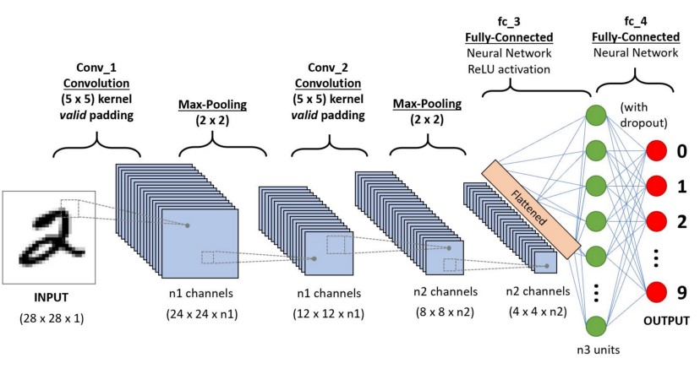
CONVOLUTIONAL NEURAL NETWORK
A convolutional neural network (CNN or ConvNet), is a network architecture for deep learning which learns directly from data, eliminating the need for manual feature extraction.
CNNs are particularly useful for finding patterns in images to recognize objects, faces, and scenes.
They can also be quite effective for classifying non-image data such as audio, time series, and signal data.
Applications that call for object recognition and computer vision — such as self-driving vehicles and face-recognition applications — rely heavily on CNNs.

Slide 6
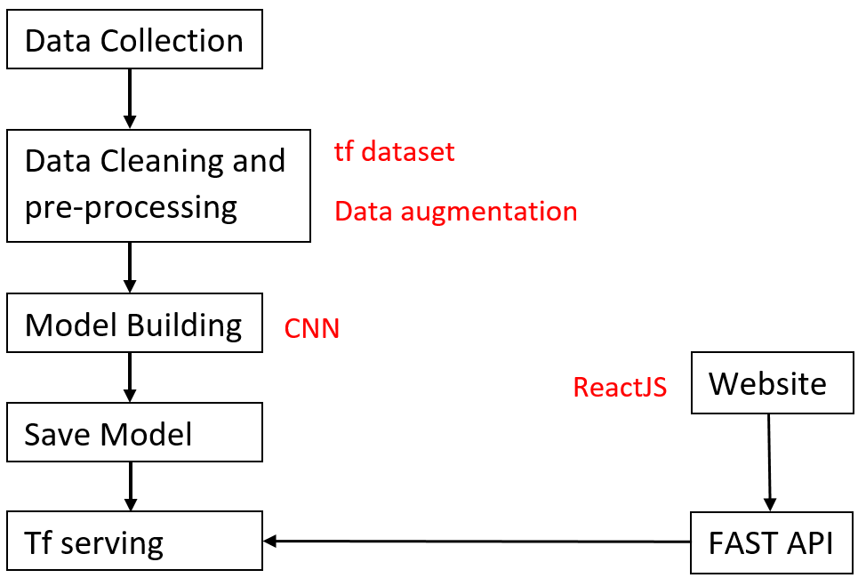
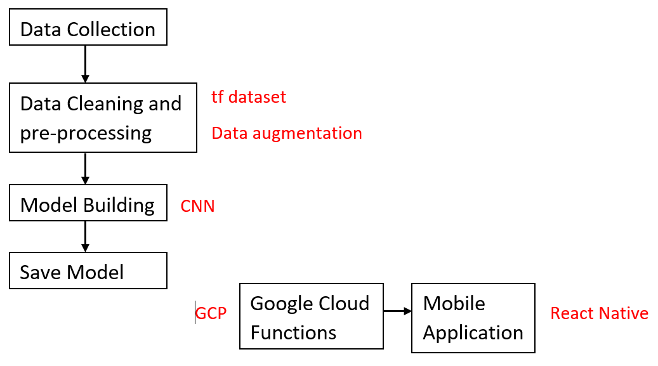
FLOW CHART
Mobile Application Architecture
Web Application Architecture

Slide 7
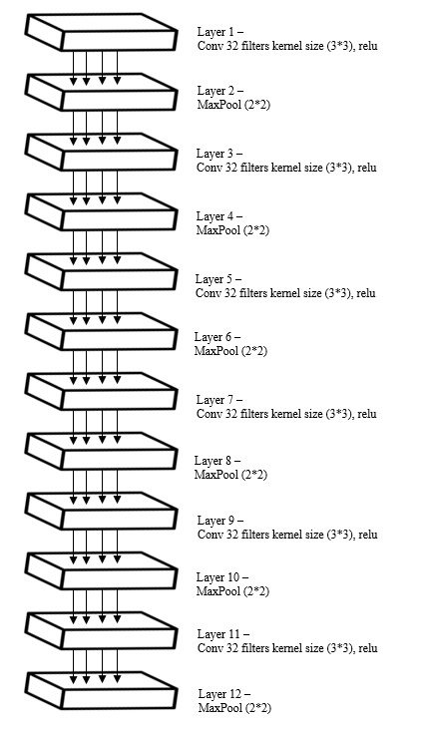
Potato Plant Disease Detection neural network (PPDDNN) model
The Potato Plant Disease Detection neural network (PPDDNN) model is used to classify the plants into three categories namely healthy, early-light affected and late-blight affected.
This model was created entirely from scratch so that the study would solely focus on photographs of plant diseases.
The model will likely classify certain attributes that are present in the subject image (Background information) into a different class after learning them during training.
Thus, we trained our model from scratch by feeding it only the respected images in a segmented way, allowing it to focus solely on the plants and its forms of ailments.

Slide 8
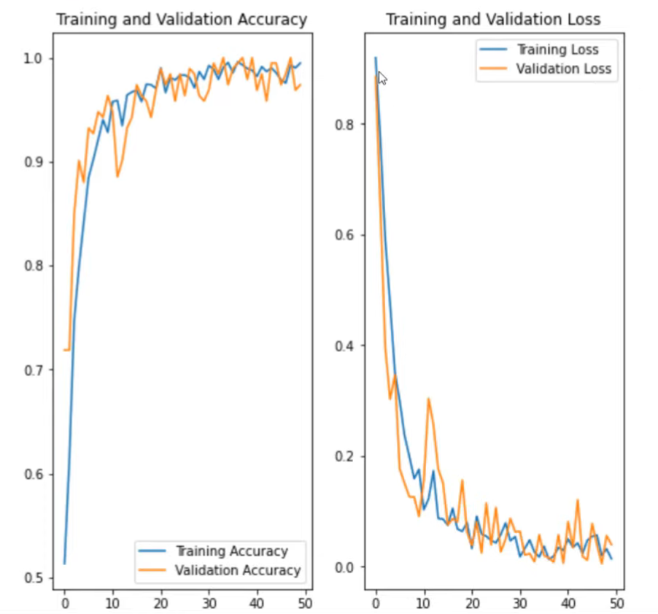
Accuracy and loss chart

Slide 9
COMPARITIVE ANALYSIS
Types of Neural Networks | Artificial Neural Networks (ANN) | Convolutional Neural Networks (CNN) | Recurrent Neural Networks (RNN)
Type of Data | Tabular Data Text Data | Image Data | Sequence Data
Parameter Sharing | ❌ | ✔️ | ✔️
Fixed Length input | ✔️ | ✔️
Recurrent Connections | ❌ | ❌ | ✔️
Vanishing and Exploding Gradient | ✔️ | ✔️ | ✔️
Spatial Relationship | ❌ | ✔️ | ❌
Performance | ANN is less powerful than RNN, CNN | CNN is more powerful than ANN, RNN | When compared to CNN, RNN has fewer feature compatibility.
Application | Facial recognition and Computer vision. | Facial recognition, text digitalization and Natural language processing | Text-to-speech conversations.

Slide 10
TECHNOLOGY STACK
Model Building:
TensorFlow
Keras
Back-End Server
Fast API
Model Optimization
TensorFlow Lite
Front-End and Deployment
React
React Native
Google Cloud Function

Slide 11
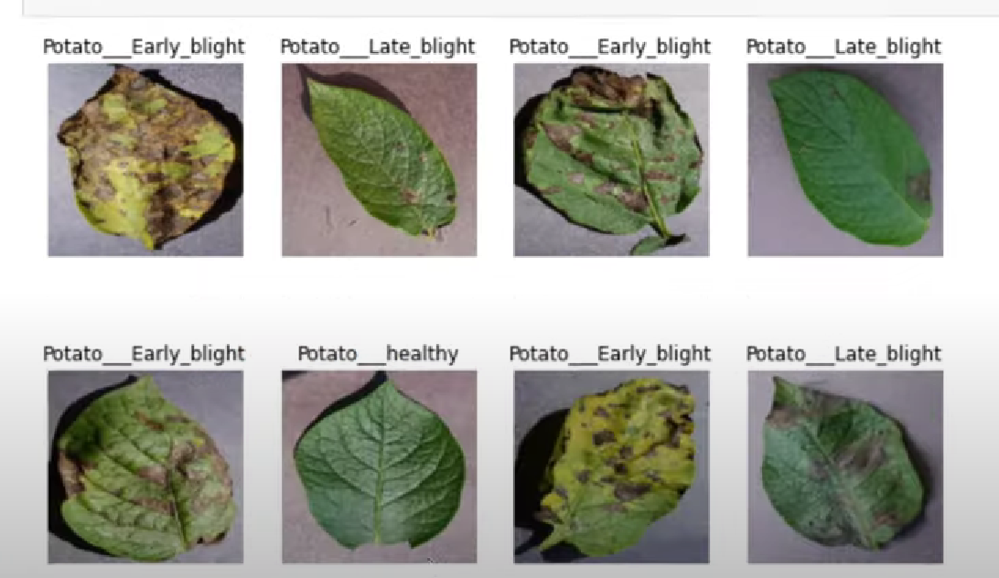
PROJECT DESIGN
Our goal was to create our own data set, which would include roughly 2342 images of various potato plants having different diseases.
Each of these entities would then be divided into three categories, one for healthy leaves, late blight diseased leaves and for early blight diseased leaves.
Deep learning model accuracy is heavily dependent on the quality, quantity, and contextual significance of training data.
However, one of the most prevalent obstacles in developing deep learning models is a lack of data.
Collecting such data in industrial use cases may be costly and time-consuming.
As a result, data augmentation, which is the act of artificially boosting the amount of data by producing new data points from existing data, is used.
This includes making minimal changes to data or utilizing machine learning models to produce new data points in the original data's latent space to amplify the dataset.

Slide 12
LITERATURE REVIEW
EXISTING PAPERS | REVIEWING EXISTING PAPERS
F. Marzougui, M. Elleuch, and M. Kherallah, “A deep CNN approach for plant disease detection. | It costs money and takes time for experts and biological examiners to visually evaluate and diagnose the plants they are carrying. • This motivated the adoption of computer methods for analyzing leaf photos to detect plant blights using image processing and deep learning. •
M. Bhagat, D. Kumar, R. Mahmood, B. Pati, and M. Kumar, “Bell pepper leaf disease classification using CNN, | Deep learning using a convolutional neural network has been very successful in classifying many different types of plant disease. • This model detects plant illness in the bell pepper plant. In this study, CNN was applied to photos of bell pepper plants, and a range of modelling methodologies for neurons and layers were used. • Disease control may be aided by accurate plant disease detection data. This strategy would boost agricultural growth and cultivation.

Slide 13
P. V. Raja, K. Sangeetha, B. A. Ninisa, M. Samiksha, and S. S. Sanjutha, “Convolutional Neural Networks based Classification and Detection of Plant Disease, | This work investigates the problem of plant disease classification, which is done visually for the identification of plant disease. Photographs of plant-related diseases are more likely to feature randomly dispersed lesions, varying symptoms, and complicated backdrops, making discriminative information difficult to capture. This study compares the performance of the ResNet-50 deep learning architecture to CNN and deep learning models in the categorization of plant leaf diseases.
H. Ajra, M. K. Nahar, L. Sarkar, and M. S. Islam, “Disease Detection of Plant Leaf using Image Processing and CNN with Preventive Measures, | Agriculture is a critical field for meeting the world's growing population's fundamental food needs. Meanwhile, the growth of grains and vegetables is critical to human nourishment and the global economy. • Many farmers cultivate in remote places of the world due to a lack of correct knowledge and disease detection, yet they rely on manual observation of grains and vegetables, resulting in significant losses.

Slide 14
J. V. Tembhurne, S. M. Gajbhiye, V. R. Gannarpwar, H. R. Khandait, P. R. Goydani, and T. Diwan, “Plant disease detection using deep learning based Mobile application,” | Every year, plant diseases destroy a huge amount of the world's crops. A smartphone application for identifying and classifying plant illness was built in this study utilizing a deep learning object detection model. Experiments using grape disease photographs revealed that the proposed application may obtain an accuracy of 97.9% while running entirely on a smartphone and without connecting to a server.
J. Kolli, D. M. Vamsi, and V. M. Manikandan, “Plant Disease Detection using Convolutional Neural Network,” | Crop production is important in the agricultural sector. Food loss is mostly related to contaminated crops, which reduces the rate of development. It is incredibly difficult to identify plant disease in the agricultural field. • When identification is inaccurate, the product's assembly and the market's economic value suffer severe losses. Crop production is important in the agricultural sector. Food loss is mostly related to contaminated crops, which reduces the rate of development. It is incredibly difficult to identify plant disease in the agricultural field.

Slide 15
THANK YOU

